Slide 1
Computational Fluid Dynamics (CFD)
DAY 4
Kumaresh

Slide 2
Contents
Numerical stability
Advection equation
Exercise – 4 (i) and (ii)

Slide 3
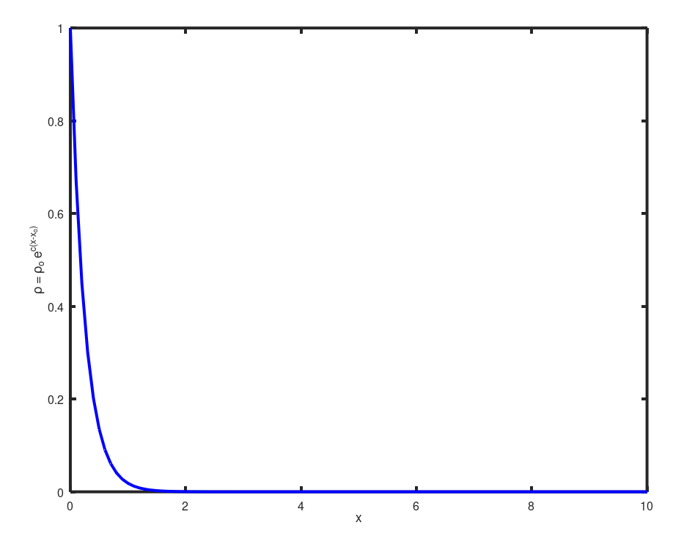
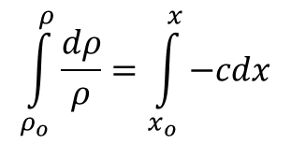
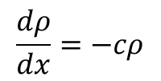
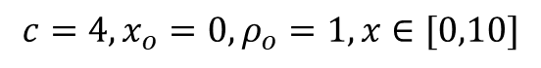
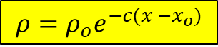
Numerical Stability
Numerical approach should not magnify the error that appears in the solution.
$$\frac{dρ}{dx}=−cρ$$
$$\int_{ρ_{o}}^{ρ}{\frac{dρ}{ρ}}=\int_{x_{o}}^{x}{−cdx}$$
Analytical
$$ρ=ρ_{o}e^{−c(x −x_{o})}$$
$$c=4, x_{o}=0, ρ_{o}=1, x∈[0,10]$$

Slide 4
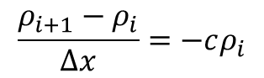
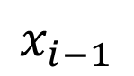
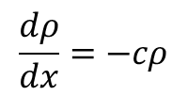
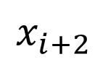
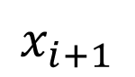
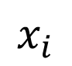
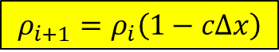
Numerical Stability
Numerical discretization
$$\frac{dρ}{dx}=−cρ$$
$$x_{i−1}$$
$$x_{i}$$
$$x_{i+1}$$
$$x_{i+2}$$
$$\frac{ρ_{i+1}−ρ_{i}}{Δx}=−cρ_{i}$$
Numerical
$$ρ_{i+1}=ρ_{i}\left(1−cΔx\right)$$

Slide 5
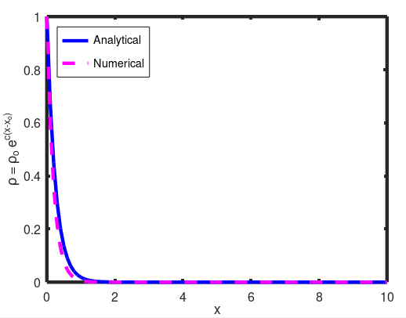
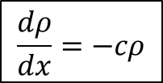
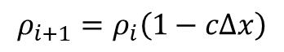
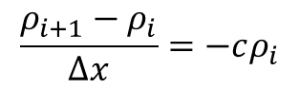
Numerical Stability
Numerical discretization
$$x_{i−1}$$
$$x_{i}$$
$$x_{i+1}$$
$$x_{i+2}$$
$$\frac{dρ}{dx}=−cρ$$
$$\frac{ρ_{i+1}−ρ_{i}}{Δx}=−cρ_{i}$$
$$ρ_{i+1}=ρ_{i}\left(1−cΔx\right)$$
$$c=4, x_{o}=0, ρ_{o}=1, x∈\left[0,10\right], Δx=0.1$$

Slide 6
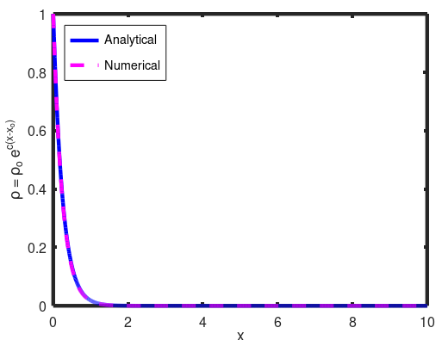
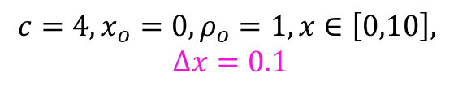
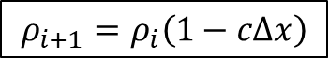
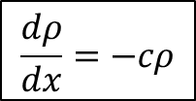
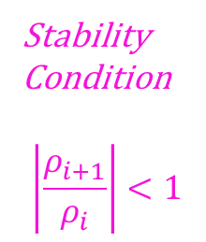
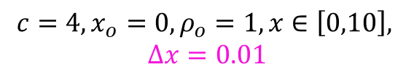
Numerical Stability
$$x_{i−1}$$
$$x_{i}$$
$$x_{i+1}$$
$$x_{i+2}$$
$$\frac{dρ}{dx}=−cρ$$
$$ρ_{i+1}=ρ_{i}\left(1−cΔx\right)$$
Stability
Condition
$$\left|\frac{ρ_{i+1}}{ρ_{i}}\right|<1$$
$$c=4, x_{o}=0, ρ_{o}=1, x∈\left[0,10\right],$$
$$Δx=0.1$$
$$c=4, x_{o}=0, ρ_{o}=1, x∈\left[0,10\right],$$
$$Δx=0.01$$

Slide 7
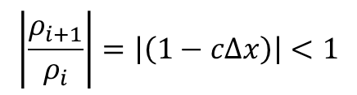
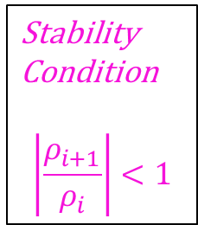
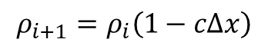
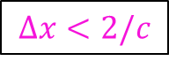
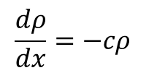
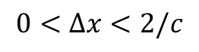
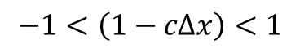
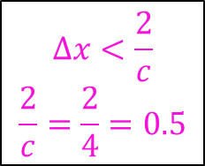
Numerical Stability
Stability
Condition
$$\left|\frac{ρ_{i+1}}{ρ_{i}}\right|<1$$
$$\frac{dρ}{dx}=−cρ$$
$$x_{i−1}$$
$$x_{i}$$
$$x_{i+1}$$
$$x_{i+2}$$
$$ρ_{i+1}=ρ_{i}\left(1−cΔx\right)$$
$$\left|\frac{ρ_{i+1}}{ρ_{i}}\right|=\left|\left(1−cΔx\right)\right|<1$$
$$−1<\left(1−cΔx\right)<1$$
$$0<Δx<2/c$$
$$Δx<\frac{2}{c}$$
$$\frac{2}{c}=\frac{2}{4}=0.5$$
$$Δx<2/c$$

Slide 8
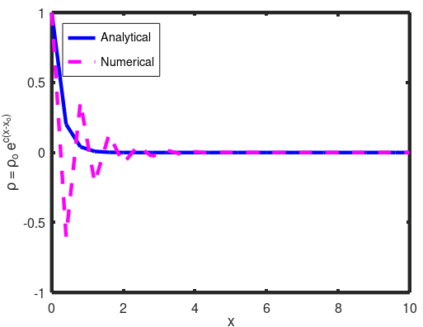
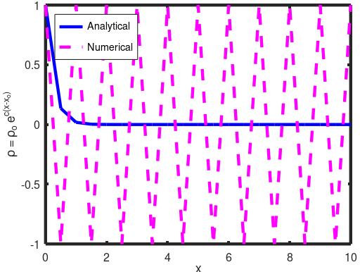
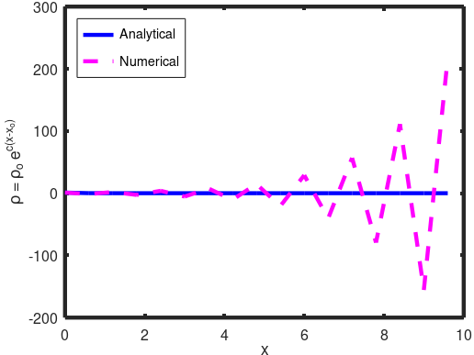
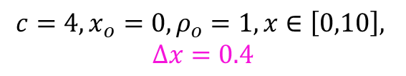
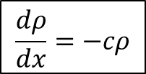
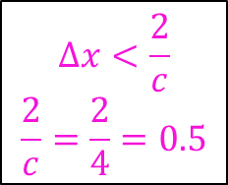
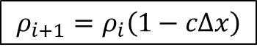
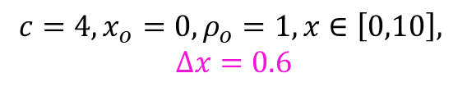
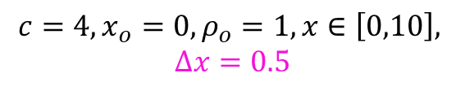
Numerical Stability
$$Δx<\frac{2}{c}$$
$$\frac{2}{c}=\frac{2}{4}=0.5$$
$$x_{i−1}$$
$$x_{i}$$
$$x_{i+1}$$
$$x_{i+2}$$
$$\frac{dρ}{dx}=−cρ$$
$$ρ_{i+1}=ρ_{i}\left(1−cΔx\right)$$
$$c=4, x_{o}=0, ρ_{o}=1, x∈\left[0,10\right],$$
$$Δx=0.4$$
$$c=4, x_{o}=0, ρ_{o}=1, x∈\left[0,10\right],$$
$$Δx=0.5$$
$$c=4, x_{o}=0, ρ_{o}=1, x∈\left[0,10\right],$$
$$Δx=0.6$$

Slide 10
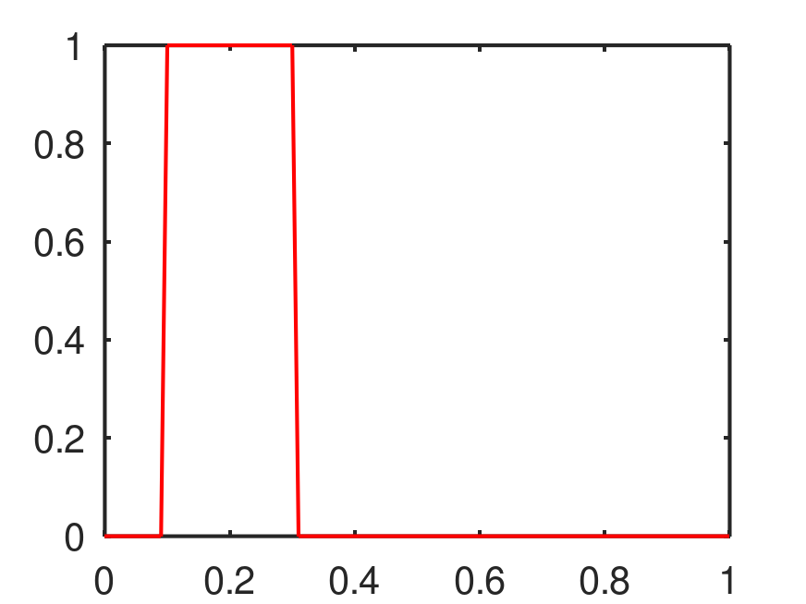
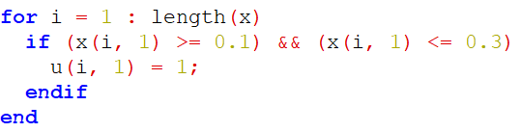
Numerical Stability - Advection equation

Slide 11
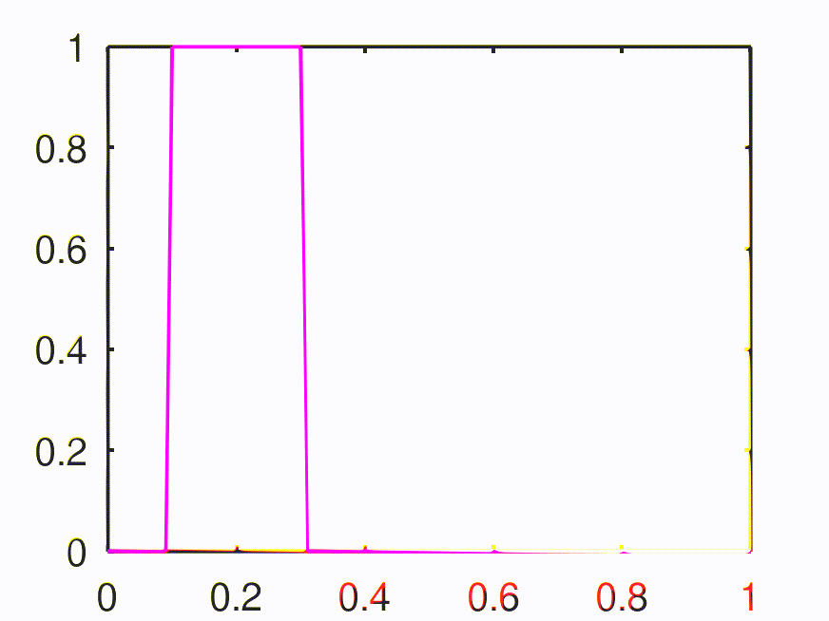
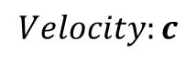
Numerical Stability - Advection equation
$$Velocity:c$$

Slide 12
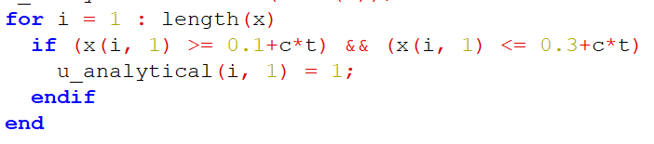
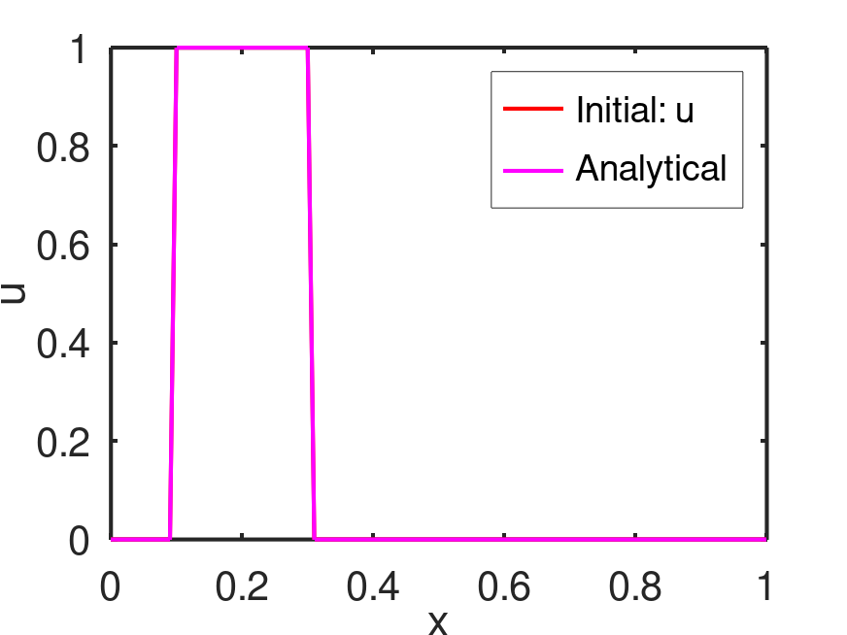
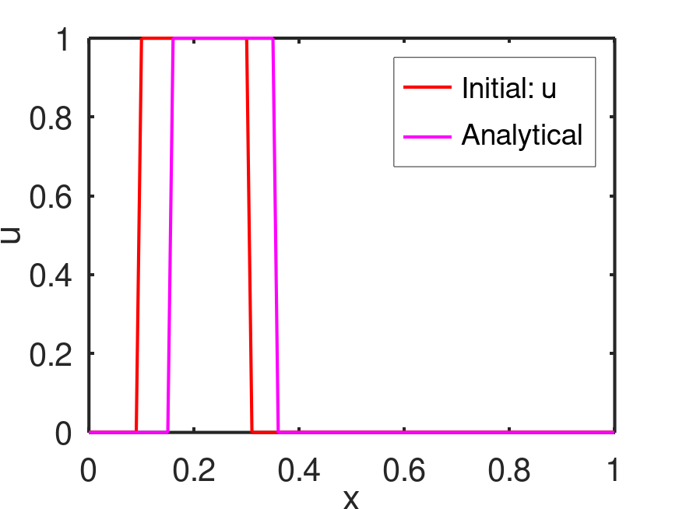
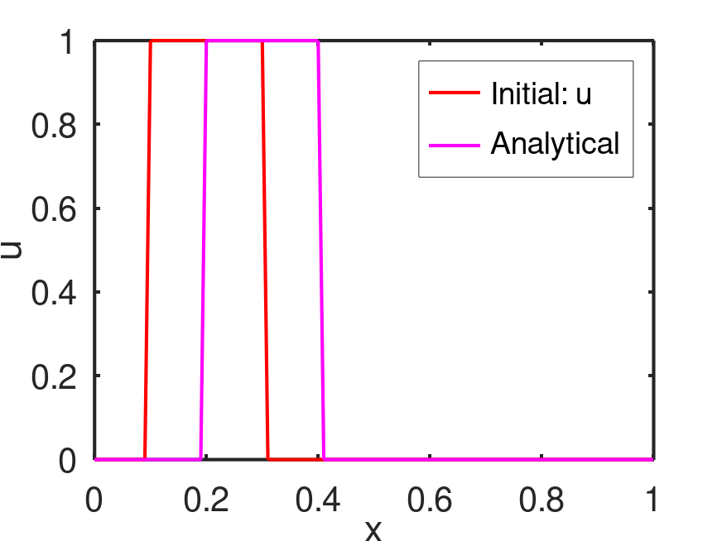
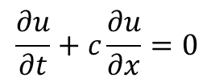
Numerical Stability - Advection equation
$$\frac{∂u}{∂t}+c\frac{∂u}{∂x}=0$$
Advection equation

Slide 13
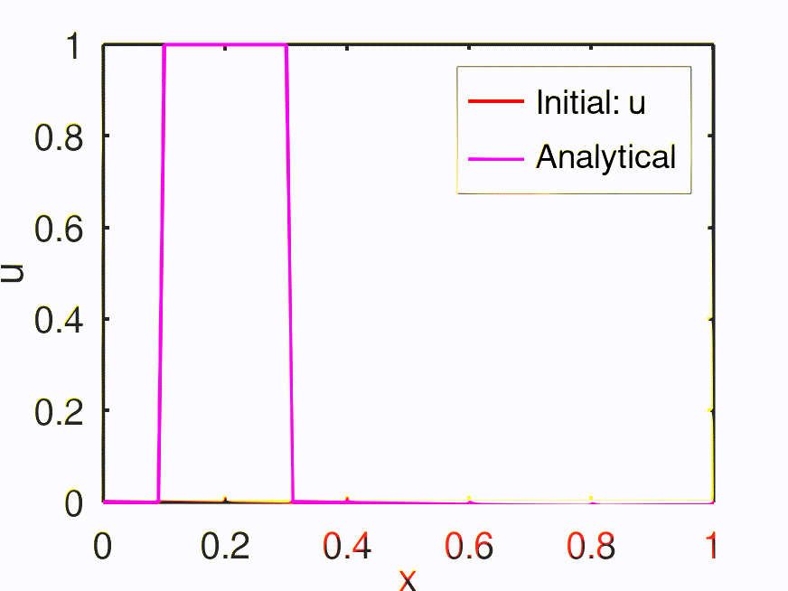
Numerical Stability - Advection equation

Slide 14
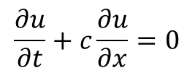
Exercise – 4 (i)
$$x_{i−1}$$
$$x_{i}$$
$$x_{i+1}$$
$$x_{i+2}$$
Solve the following advection equation analytically in octave
Upload in GitHub
$$\frac{∂u}{∂t}+c\frac{∂u}{∂x}=0$$

Slide 16






Numerical Stability - Advection equation
$$\frac{∂u}{∂t}+c\frac{∂u}{∂x}=0$$
$$\frac{u_{i}^{n+1}−u_{i}^{n}}{Δt}+c{\left(\frac{∂u}{∂x}\right)}_{i}^{n}=0$$
$$x_{i−1}$$
$$x_{i}$$
$$x_{i+1}$$
$$x_{i+2}$$
$${\left(\frac{∂u}{∂x}\right)}_{i}^{n}≈\frac{u_{i+1}^{n}−u_{i}^{n}}{Δx_{i}}$$
Simple forward
difference scheme
$$u_{i}^{n+1}=u_{i}^{n}−cΔt{\left(\frac{∂u}{∂x}\right)}_{i}^{n}$$
$${\left(\frac{∂u}{∂x}\right)}_{i}^{n}≈\frac{u_{i+1}^{n}−u_{i−1}^{n}}{2Δx_{i}}$$
Central difference
(Explicit) First order - Forward Euler
(only one unknown (n+1) with other knowns at n^{th} node) → conditionally stable

Slide 17










Numerical Stability - Advection equation
Time level: $n+1$
$$x_{i−1}$$
$$x_{i}$$
$$x_{i+1}$$
$$x_{i+2}$$
Time level: $n$
$$x_{i+1}$$
$$x_{i+2}$$
$$x_{i−1}$$
$$x_{i}$$
Information from right to left end
$${\left(\frac{∂u}{∂x}\right)}_{i}^{n}≈\frac{u_{i+1}^{n}−u_{i}^{n}}{Δx_{i}}$$
Simple forward
difference scheme
$$u_{i}^{n+1}=u_{i}^{n}−cΔt{\left(\frac{∂u}{∂x}\right)}_{i}^{n}$$
$${\left(\frac{∂u}{∂x}\right)}_{i}^{n}≈\frac{u_{i+1}^{n}−u_{i−1}^{n}}{2Δx_{i}}$$
Central difference

Slide 18




Application: Differential equation used in physics, weather forecasting, stoke markets behaviors (based on probability, past and present information and predicting future information)
Numerical Stability - Advection equation
Time level: $n+1$
$$x_{i−1}$$
$$x_{i}$$
$$x_{i+1}$$
$$x_{i+2}$$
Time level: $n$
$$x_{i+1}$$
$$x_{i+2}$$
$$x_{i−1}$$
$$x_{i}$$
Information from left and right ends
$${\left(\frac{∂u}{∂x}\right)}_{i}^{n}≈\frac{u_{i+1}^{n}−u_{i}^{n}}{Δx_{i}}$$
Simple forward
difference scheme
$$u_{i}^{n+1}=u_{i}^{n}−cΔt{\left(\frac{∂u}{∂x}\right)}_{i}^{n}$$
$${\left(\frac{∂u}{∂x}\right)}_{i}^{n}≈\frac{u_{i+1}^{n}−u_{i−1}^{n}}{2Δx_{i}}$$
Central difference

Slide 19




Numerical Stability - Advection equation
Time level: $n+1$
$$x_{i−1}$$
$$x_{i}$$
$$x_{i+1}$$
$$x_{i+2}$$
Time level: $n$
$$x_{i+1}$$
$$x_{i+2}$$
$$x_{i−1}$$
$$x_{i}$$
Information from left to right end
Wind is flowing from left end (bird moves from left to right)
$$u_{i}^{n+1}=u_{i}^{n}−cΔt{\left(\frac{∂u}{∂x}\right)}_{i}^{n}$$
$${\left(\frac{∂u}{∂x}\right)}_{i}^{n}≈\frac{u_{i}^{n}−u_{i−1}^{n}}{Δx_{i}}$$
Simple backward
difference scheme

Slide 20






Numerical Stability - Advection equation
$$\frac{∂u}{∂t}+c\frac{∂u}{∂x}=0$$
$$u_{i}^{n+1}=u_{i}^{n}−cΔt{\left(\frac{∂u}{∂x}\right)}_{i}^{n}$$
$${\left(\frac{∂u}{∂x}\right)}_{i}^{n}≈\frac{u_{i}^{n}−u_{i−1}^{n}}{Δx_{i}}$$
Simple backward
difference scheme
Upwind
scheme
Information from left to right end
Wind is flowing from left end (Flowing towards the source of the wind)
$$u_{i}^{n+1}=u_{i}^{n}−cΔt{\left(\frac{∂u}{∂x}\right)}_{i}^{n}$$
$${\left(\frac{∂u}{∂x}\right)}_{i}^{n}≈\frac{u_{i+1}^{n}−u_{i}^{n}}{Δx_{i}}$$
Simple forward
difference scheme
$$CFL: \frac{cΔt}{Δx}$$
CFL = 0.1
Downwind scheme
Courant - Friedrichs - Lewy Number

Slide 21







Numerical Stability - Advection equation
$$u_{i}^{n+1}=u_{i}^{n}−cΔt{\left(\frac{∂u}{∂x}\right)}_{i}^{n}$$
$${\left(\frac{∂u}{∂x}\right)}_{i}^{n}≈\frac{u_{i}^{n}−u_{i−1}^{n}}{Δx_{i}}$$
Simple backward
difference scheme
Upwind scheme
$$CFL: \frac{cΔt}{Δx}$$
CFL = 1.5
$$Δt$$
increase

Slide 22




What did we discuss ?
Proper discrete approximations need to be chosen based on the velocity field.
CFL number is critical to ensure numerical stability.
Upwind scheme
$$u_{i}^{n+1}=u_{i}^{n}−cΔt{\left(\frac{∂u}{∂x}\right)}_{i}^{n}$$
$${\left(\frac{∂u}{∂x}\right)}_{i}^{n}≈\frac{u_{i}^{n}−u_{i−1}^{n}}{Δx_{i}}$$
Simple backward
difference scheme
Downwind scheme
$$u_{i}^{n+1}=u_{i}^{n}−cΔt{\left(\frac{∂u}{∂x}\right)}_{i}^{n}$$
$${\left(\frac{∂u}{∂x}\right)}_{i}^{n}≈\frac{u_{i+1}^{n}−u_{i}^{n}}{Δx_{i}}$$
Simple forward
difference scheme

Slide 23

Exercise – 4 (ii)
$$x_{i−1}$$
$$x_{i}$$
$$x_{i+1}$$
$$x_{i+2}$$
Solve the following advection equation numerically in octave
Central difference with CFL = 0.1 (dx = 0.01, c = 0.01, dt = 0.1, t_final = 5)
Upwind scheme (backward difference) with CFL = 0.1 (dx = 0.01, dt = 0.1, t_final = 5). Change the ”c” value between 0.01 and -0.01 and analyze the stability. Hint: Upwind scheme with c = -0.01 becomes unstable and act as downwind.
Downwind scheme (forward difference) with CFL = 0.1 (dx = 0.01, dt = 0.1, t_final = 5). Change the ”c” value between 0.01 and -0.01 and analyze the stability. Hint: Downwind scheme with c = -0.01 becomes stable and act as upwind.
Examine CFL numbers. Analyse the upwind scheme with CFL = 0.1, 1.0, and 10. Analyze the stability. (dx = 0.01, c = 0.01, dt = 0.1, t_final = 5)
Upload in GitHub.
$$\frac{∂u}{∂t}+c\frac{∂u}{∂x}=0$$

